Slide 1

Elementary Programming
University of Human Development College of Science and Technology Department of IT
Lecture :Programming
Lecturer: Tara Qadr
1st stage 2015-2016

Slide 2
Objectives
To know about Data and data types
To use identifiers to name variables, constants, methods, and classes.
To use of variables to store data.
To use constants to store permanent data.
To know about Algorithms.
To program with assignment statements and expressions.
To use Java operators to write expressions.
To become familiar with Java documentation, programming style.

Slide 3
Fundamental Building Blocks of Programs
There are two basic aspects of programming:
Data: To work with data, you need to understand variables and types.
Instructions: to work with instructions, you need to understand control structures and subroutines.

Slide 4
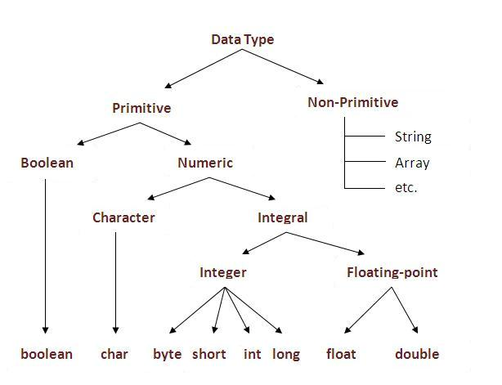
Data Types
In java, there are two types of data types primitive data types non-primitive data types Type: A category or set of data values. data type : refers to the type of data that can be stored.

Slide 5
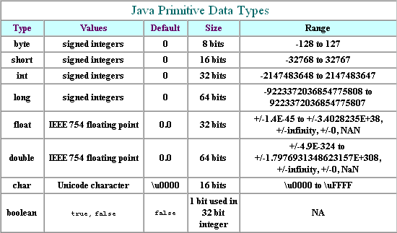
Java's Primitive Data Types

Slide 6
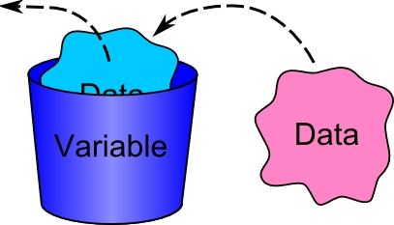
Variables
Variables are used to store data in a program.
Variables represents a value stored in computer’s memory.
Variables are for representing data of a certain type.
A variable is just a memory location that has been given a name.

Slide 7
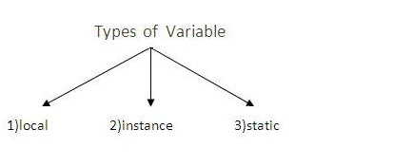
Types of Variable
Local Variable: A variable that is declared inside the method is called local variable.
Instance Variable : A variable that is declared inside the class but outside the method is called instance variable . It is not declared as static.
Static variable : A variable that is declared as static is called static variable. It cannot be local.

Slide 8
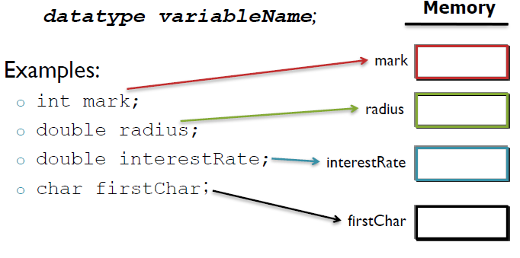
Declaring Variables
Every variable must be declared, before it can be used.
Declaring a variable means informing the compiler of the variable's name and its type.
The syntax for declaring a variable is:

Slide 9
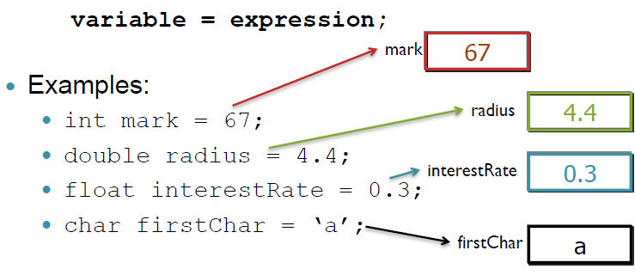
Assignment Statements
After a variable is declared, you can assign a value to it by using an assignment statement.
In Java, the equal sign (=) is used as the assignment operator.
The syntax for assignment statements is as follows:

Slide 10
Variable naming 1
Variable names or identifiers may be any length but start with
a letter (a - z)
A dollar sign ($)
Underscore( _ )
identifiers cannot keywords in java language.
for example “class”, “ static” , “ int ” .

Slide 11
Variable naming 2
Java case sensitive – capitalization matter
Book is not book and not BOOK
Choose variable name that informative.
example:
Good : int studentDgree
bad : int tempvar123
Camel case : start variable names with lower case and capitalize each word
example: circleAreaVariable

Slide 12
Question ?
Which the following variable are valid and why?
$amount
My*name
salary
First name
total
double

Slide 13
Constants
A constant represents permanent data that never changes during the process of all the instructions.
The general syntax for declaring a constant:
final datatype CONSTANTNAME = VALUE;
Example :
final double PI = 3.14159;
final int SIZE = 3;

Slide 14
Expressions
Expression: A computation involving values, variables, and operators that together evaluates to a value.
Examples:
num = 1 + 4 * 5
num = (7 + 2) * 6 / 3
The simplest expression is a literal value.
A complex expression can use operators and parentheses.

Slide 15
Solving Problem and Algorithms
Write a program for computing area of a circle.
Writing a program involves:
Designing an algorithm then
Translating the algorithm into program.
Algorithm is a list of actions that need to be taken in order to solve a problem.
Algorithm can help programmer to plan a program
It can be described in natural language or in pseudo code.
Pseudo code: is natural language mixed with some programming code.

Slide 16
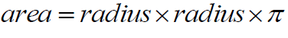
Writing a Simple Java Program (1)
Write a program for calculating area of a circle.
The algorithm for calculating area of a circle can be described as follows:
Read the circle’s radius.
Compute the area using the following formula:
Display the result.

Slide 17
Writing a Simple Java Program (2)
The program needs to read the radius.
In order to store the radius, the program needs to declare a symbol called variable.
public class ComputeArea {
public static void main(String[] args) {
double radius;
// Step1: Read the radius
// Step 2: Compute area
// Step 3: Display the area
}
}

Slide 18
Writing a Simple Java Program (3)
Assign a value to variable radius:
public class ComputeArea {
public static void main(String[] args) {
double radius; // declare radius
radius = 20; // assign radius
// Step 2: Compute area
// Step 3: Display the area
}
}

Slide 19
Writing a Simple Java Program (4)
Compute area using the following formula:
The result must be stored in the program so we need a variable for the result.
public class ComputeArea {
public static void main(String[] args) {
double radius; // declare radius
double area;
radius = 20; // assign radius
// Step 2: Compute area
area = radius * radius * 3.14;
// Step 3: Display the area
}

Slide 20
Writing a Simple Java Program (5)
Now we can display the result.
public class ComputeArea {
public static void main(String[] args) {
double radius; // declare radius
double area;
radius = 20;// assign radius
// Step 2: Compute area
area = radius * radius * 3.14;
// Step 3: Display the area
System.out.println(“ The area of the circle of radius “ + radius + “ = “ + area);
}
}

Slide 21
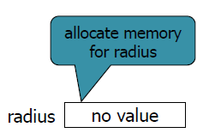
Example: Trace a Program Execution (1)
/*author:
This Program computes area of a circle */
public class ComputeArea {
/* Main method */
public static void main(String[] args) {
double radius;
double area;
// Assign the radius
radius = 20;
// Compute area
area = radius * radius * 3.14159;
// Display results
System.out.println("The area for the circle of radius " +
radius + " is " + area);
}
}

Slide 22
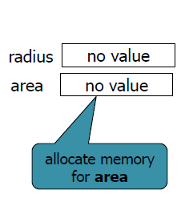
Example: Trace a Program Execution (2)
/*author:
This Program computes area of a circle */
public class ComputeArea {
/* Main method */
public static void main(String[] args) {
double radius;
double area;
// Assign the radius
radius = 20;
// Compute area
area = radius * radius * 3.14159;
// Display results
System.out.println("The area for the circle of radius " +
radius + " is " + area);
}
}

Slide 23
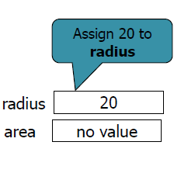
Example: Trace a Program Execution (3)
/*author:
This Program computes area of a circle */
public class ComputeArea {
/* Main method */
public static void main(String[] args) {
double radius;
double area;
// Assign the radius
radius = 20;
// Compute area
area = radius * radius * 3.14159;
// Display results
System.out.println("The area for the circle of radius " +
radius + " is " + area);
}
}

Slide 24
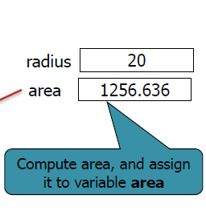
Example: Trace a Program Execution (4)
/*author:
This Program computes area of a circle */
public class ComputeArea {
/* Main method */
public static void main(String[] args) {
double radius;
double area;
// Assign the radius
radius = 20;
// Compute area
area = radius * radius * 3.14159;
// Display results
System.out.println("The area for the circle of radius " +
radius + " is " + area);
}
}

Slide 25
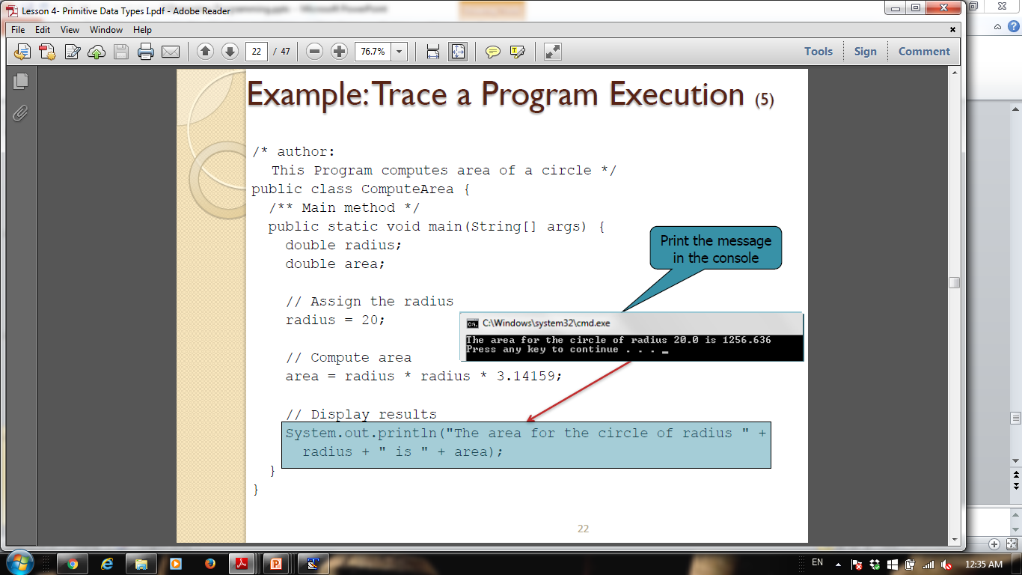
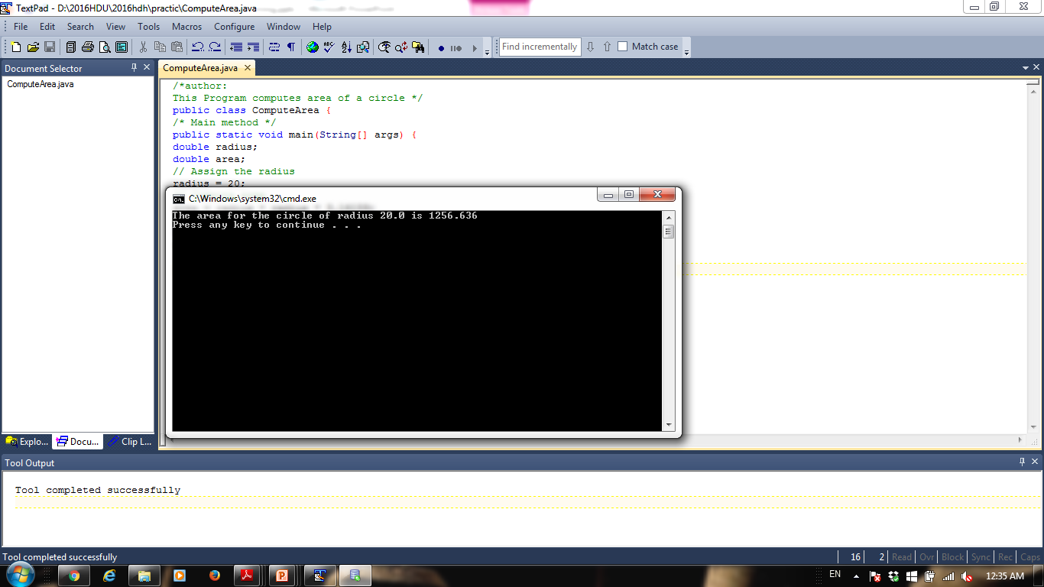
Example: Trace a Program Execution (5)
/*author:
This Program computes area of a circle */
public class ComputeArea {
/* Main method */
public static void main(String[] args) {
double radius;
double area;
// Assign the radius
radius = 20;
// Compute area
area = radius * radius * 3.14159;
// Display results
System.out.println("The area for the circle of radius " +
radius + " is " + area);
}
}

Slide 26
Home work
2) Write a program to find Total and average of 10 numbers?
3) Write a program to find Area and Perimeter of Rectangle if
length = 25 and Width = 10 ?

Slide 27
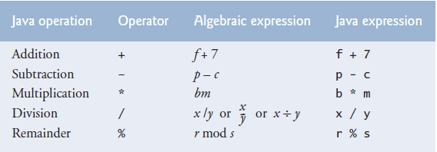
Arithmetic Operators (1)

Slide 28
Arithmetic Operators (2)
As a program runs, its expressions are evaluated.
1 + 1 evaluates to 2
20 % 3 evalates to 2
5 / 2 yields an integer 2.
5.0 / 2 yields a double value 2.5
5 % 2 yields 1 (the remainder of the division is always integer)
System.out.println (3 * 4); prints 12
Q: How would we print the text 3 * 4?

Slide 29
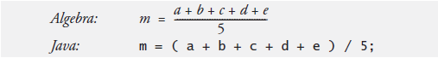
Algebraic and Java Expressions

Slide 30
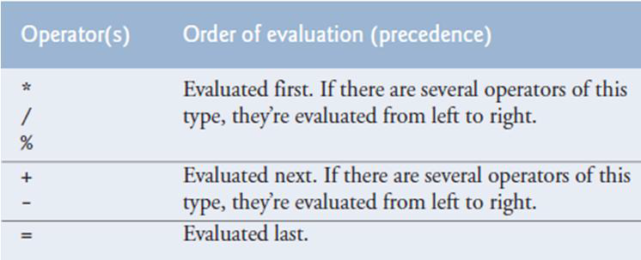
Operator Precedence
Java applies the operators in a precise sequence determined by the rules of operator precedence.

Slide 31
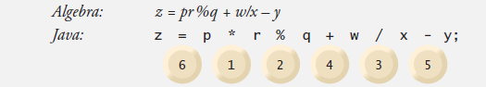
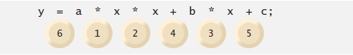
Precedence examples (1)

Slide 32
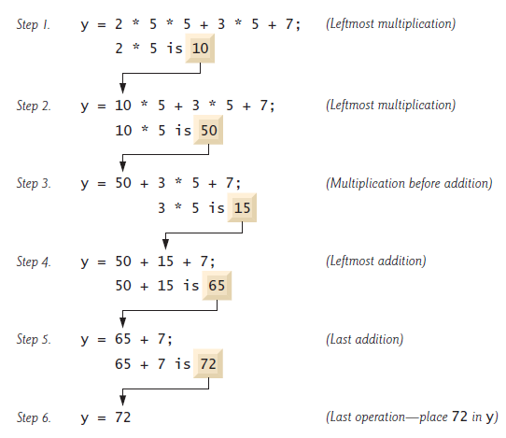
Precedence examples (2)

Slide 33
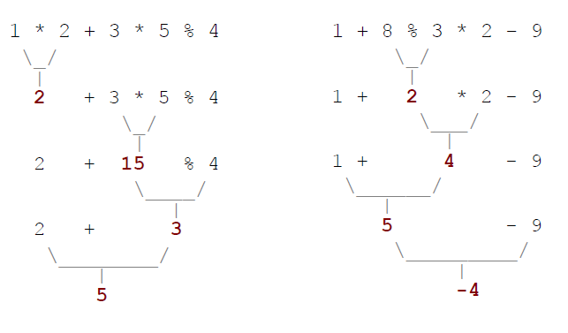
Precedence examples (3)

Slide 34
Precedence Questions
What values result from the following expressions?
9 / 5
695 % 20
7 + 6 * 5
7 * 6 + 5
248 % 100 / 5
6 * 3 -9 / 4
(5 -7) * 4
6 + (18 % (17 -12))

Slide 35
Real numbers (type double)
Examples: 6.022, -42.0, 2.143e17
Placing .0or .after an integer makes it a double.
The operators + - * / % () all still work with double.
produces an exact answer: 15.0 / 2.0 is 7.5
Precedence is the same: () before * / % before + -

Slide 36
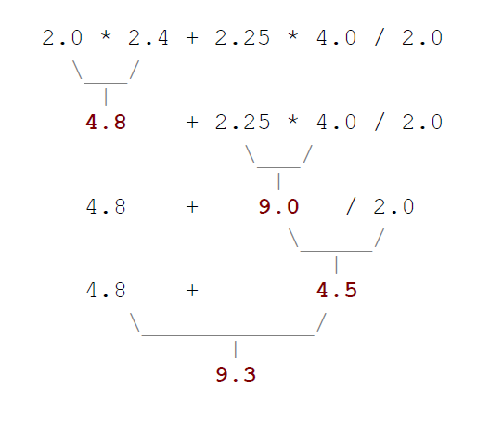
Real number example

Slide 37
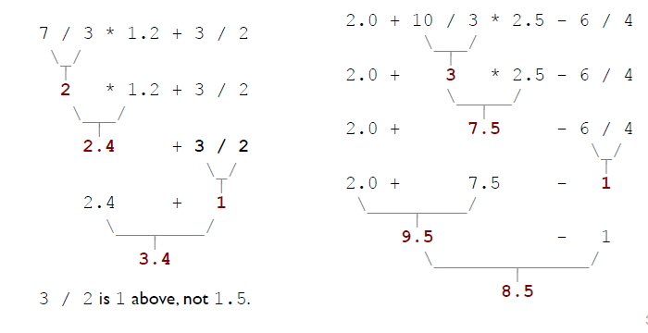
Mixing types
When int and double are mixed, the result is a double.
4.2 * 3 is 12.6
The conversion is per-operator, affecting only its operands.

Slide 38
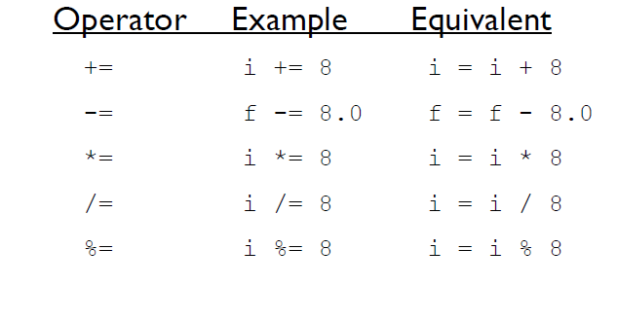
Short hand Assignment Operators

Slide 39
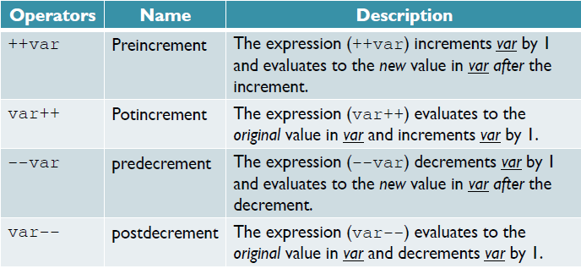
Increment and Decrement Operators (1)

Slide 40
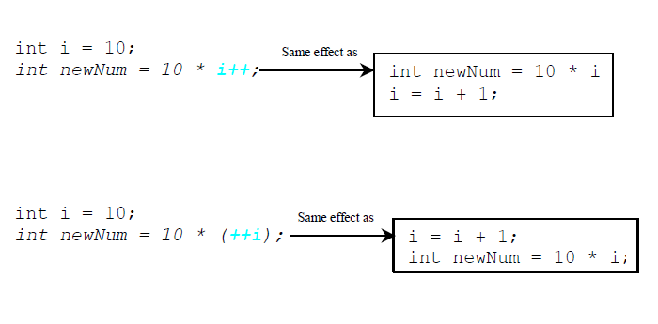
Increment and Decrement Operators (2)

Slide 41
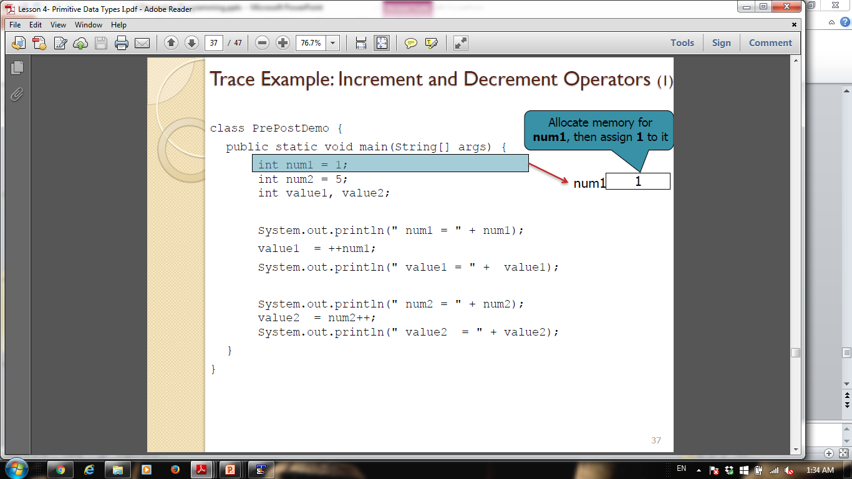
Trace Example: Increment and Decrement Operators (1)
class PrePostTest {
public static void main(String[] args) {
int num1 = 1;
int num2 = 5;
int value1, value2;
System.out.println(" num1="+ num1);
value1 =++num1;
System.out.println(" value1 ="+ value1);
System.out.println(" num2 ="+ num2);
value2 =num2++;
System.out.println(" value2 ="+ value2);
}
}
Allocate memory for num1, then assign 1 to it

Slide 42
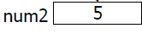
Trace Example: Increment and Decrement Operators (2)
class PrePostTest {
public static void main(String[] args) {
int num1 = 1;
int num2 = 5;
int value1, value2;
System.out.println(" num1="+ num1);
value1 =++num1;
System.out.println(" value1 ="+ value1);
System.out.println(" num2 ="+ num2);
value2 =num2++;
System.out.println(" value2 ="+ value2);
}
}
Allocate memory for num2, then assign 5 to it

Slide 43
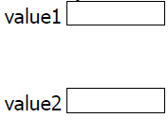
Trace Example: Increment and Decrement Operators (3)
class PrePostTest {
public static void main(String[] args) {
int num1 = 1;
int num2 = 5;
int value1, value2;
System.out.println(" num1="+ num1);
value1 =++num1;
System.out.println(" value1 ="+ value1);
System.out.println(" num2 ="+ num2);
value2 =num2++;
System.out.println(" value2 ="+ value2);
}
}
Allocate memory for value1, value2

Slide 44
Trace Example: Increment and Decrement Operators (4)
class PrePostTest {
public static void main(String[] args) {
int num1 = 1;
int num2 = 5;
int value1, value2;
System.out.println(" num1="+ num1);
value1 =++num1;
System.out.println(" value1 ="+ value1);
System.out.println(" num2 ="+ num2);
value2 =num2++;
System.out.println(" value2 ="+ value2);
}
}
Print value of num1

Slide 45
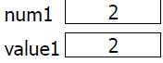
Trace Example: Increment and Decrement Operators (5)
class PrePostTest {
public static void main(String[] args) {
int num1 = 1;
int num2 = 5;
int value1, value2;
System.out.println(" num1="+ num1);
value1 =++num1;
System.out.println(" value1 ="+ value1);
System.out.println(" num2 ="+ num2);
value2 =num2++;
System.out.println(" value2 ="+ value2);
}
}
1-add 1 to num1
2-assign value1

Slide 46
Trace Example: Increment and Decrement Operators (6)
class PrePostTest {
public static void main(String[] args) {
int num1 = 1;
int num2 = 5;
int value1, value2;
System.out.println(" num1="+ num1);
value1 =++num1;
System.out.println(" value1 ="+ value1);
System.out.println(" num2 ="+ num2);
value2 =num2++;
System.out.println(" value2 ="+ value2);
}
}
Print value of variable value1

Slide 47
Trace Example: Increment and Decrement Operators (7)
class PrePostTest {
public static void main(String[] args) {
int num1 = 1;
int num2 = 5;
int value1, value2;
System.out.println(" num1="+ num1);
value1 =++num1;
System.out.println(" value1 ="+ value1);
System.out.println(" num2 ="+ num2);
value2 =num2++;
System.out.println(" value2 ="+ value2);
}
}
Print value of num2

Slide 48
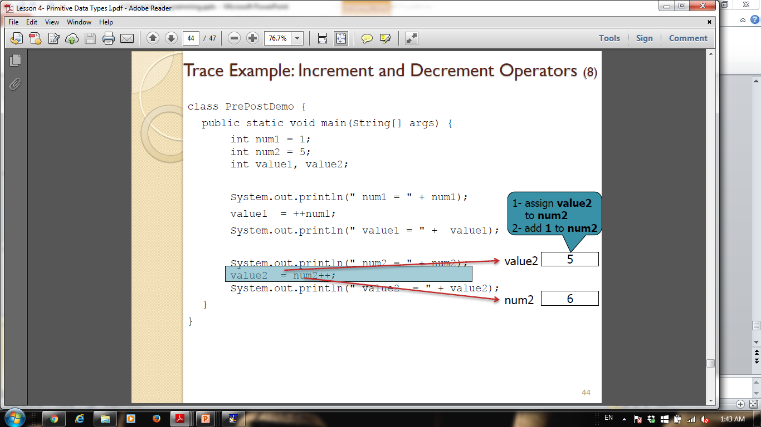
Trace Example: Increment and Decrement Operators (8)
class PrePostTest {
public static void main(String[] args) {
int num1 = 1;
int num2 = 5;
int value1, value2;
System.out.println(" num1="+ num1);
value1 =++num1;
System.out.println(" value1 ="+ value1);
System.out.println(" num2 ="+ num2);
value2 =num2++;
System.out.println(" value2 ="+ value2);
}
}
1-assign value2
to num2
2-add 1 to num2

Slide 49
Trace Example: Increment and Decrement Operators (9)
class PrePostTest {
public static void main(String[] args) {
int num1 = 1;
int num2 = 5;
int value1, value2;
System.out.println(" num1="+ num1);
value1 =++num1;
System.out.println(" value1 ="+ value1);
System.out.println(" num2 ="+ num2);
value2 =num2++;
System.out.println(" value2 ="+ value2);
}
}
Print value of variable value2

Slide 50
Reference
http://docs.oracle.com/javase/tutorial/java/nutsandbolts/datatypes.html
http://www.javatpoint.com/variable-datatype
INTRODUCTION TO JAVA PROGRAMMING COMPREHENSIVE VERSION 10th Edition
Paul Deitel , “Java How to Program”, 9thed.

Slide 51
THANK YOU

